Slide 1
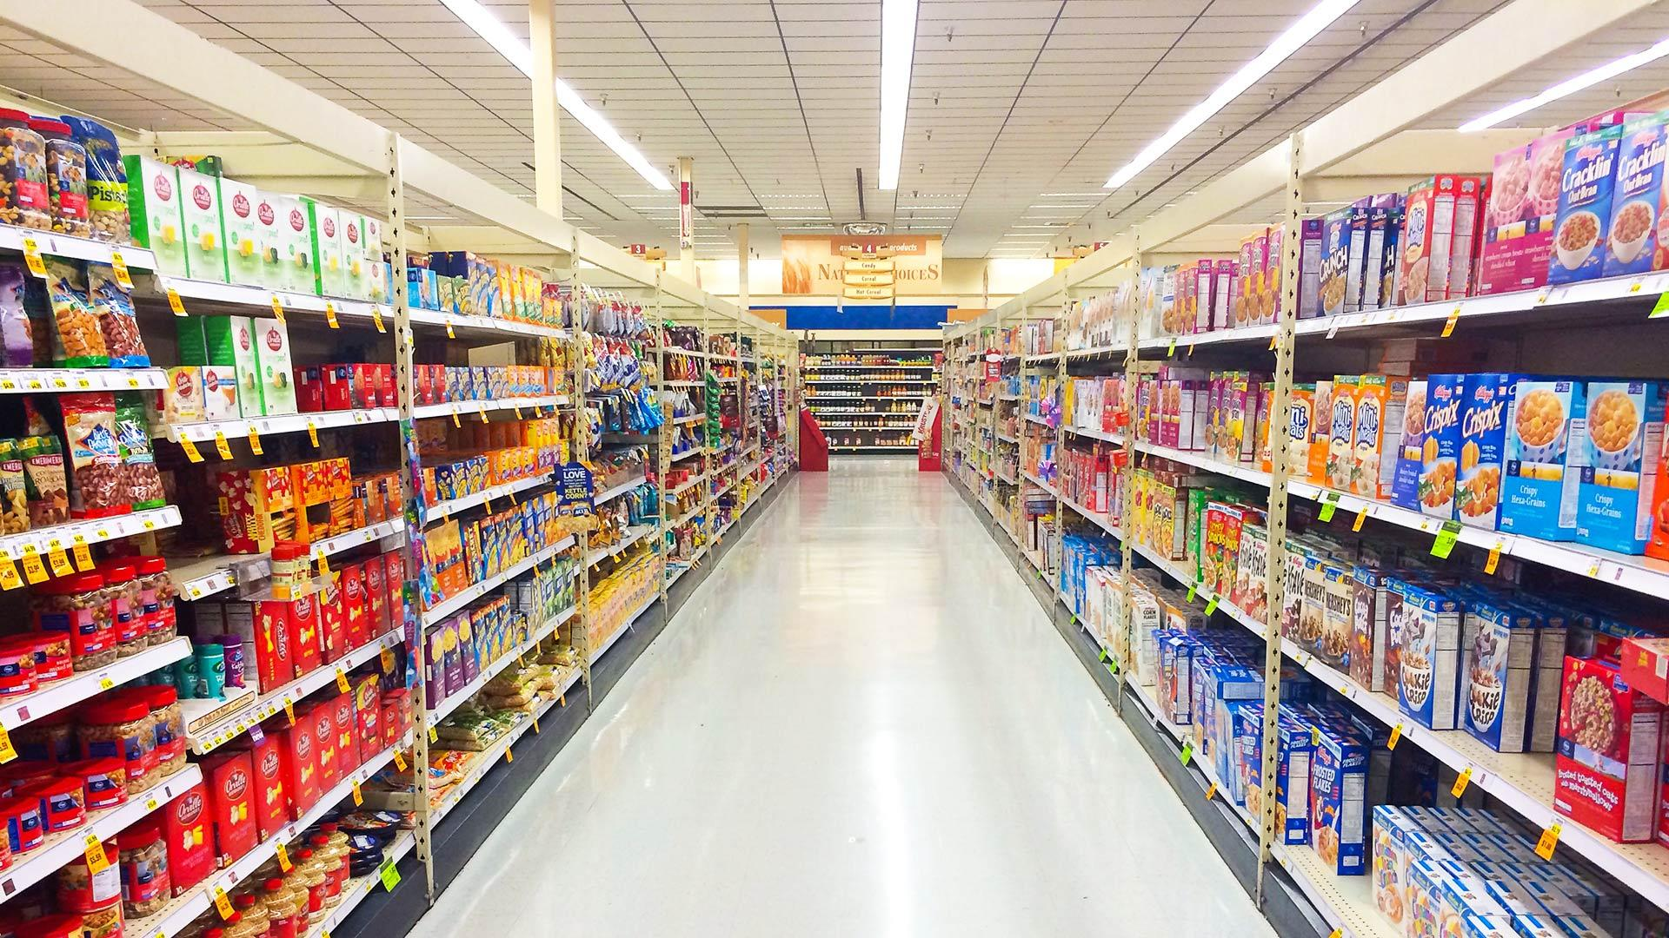

REGIONAL SUPERSTORE PERFORMANCE ANALYSIS (EDA IN TABLEAU)
PREPARED by
JOSEPHINE AKUBILLA
SUPERVISOR: Dr. ARITRI DEBNATH (Ghosh)

Slide 2

TABLE OF CONTENT
Introduction
EDA IN TABLEAU
DASHBOARD
DASHBOARD DETAILS
OTHER RELEVANT INFORMATION
Summary
THANK YOU

Slide 3

INTRODUCTION
This Tableau initiative aims to provide a comprehensive overview of customer metrics, sales, and profitability, placing specific emphasis on establishing rankings based on customer sales. The primary objective is to offer a dynamic and insightful portrayal of the company's key performance indicators (KPIs) related to customers. This will enable stakeholders to gain an enhanced understanding of customer behavior, preferences, and their impact on sales and profitability.
The project seeks to drive data-driven decision-making, enhance strategies for customer engagement, and optimize overall business performance by visually presenting essential customer information in an intuitive manner.
Additionally, the project's aim is to evaluate various aspects of customer statistics, encompassing metrics such as the total number of customers, product sales, product quantity, sales per customer, profit, and profitability per customer. A comprehensive analysis of individual clients' sales and profits will also be conducted. Moreover, the project will focus on determining the Sales Rank for each client, involving a thorough examination of client performance and prioritization.
3

Slide 4

EDA IN TABLEAU
Tableau's interactive and user-friendly interface makes it a powerful tool for exploratory data analysis. Analysts and data scientists can quickly create visualizations, dashboards, and reports to gain insights into the data and inform further analysis or decision-making processes.
In Tableau, EDA (Exploratory Data Analysis) is seamlessly integrated into dashboard creation, allowing users to visually explore and understand dataset characteristics. Through individual worksheets featuring various visualizations, users can build cohesive dashboards that offer a holistic view of the data. Leveraging Tableau's interactive features, such as dynamic filters, cross-visualization interactions, and responsive design, users can dynamically analyze and uncover insights. The platform's iterative exploration capabilities make it a powerful tool for EDA within the context of dashboard creation, facilitating a user-friendly and visually compelling exploration of data patterns, trends and outliers.

Slide 5
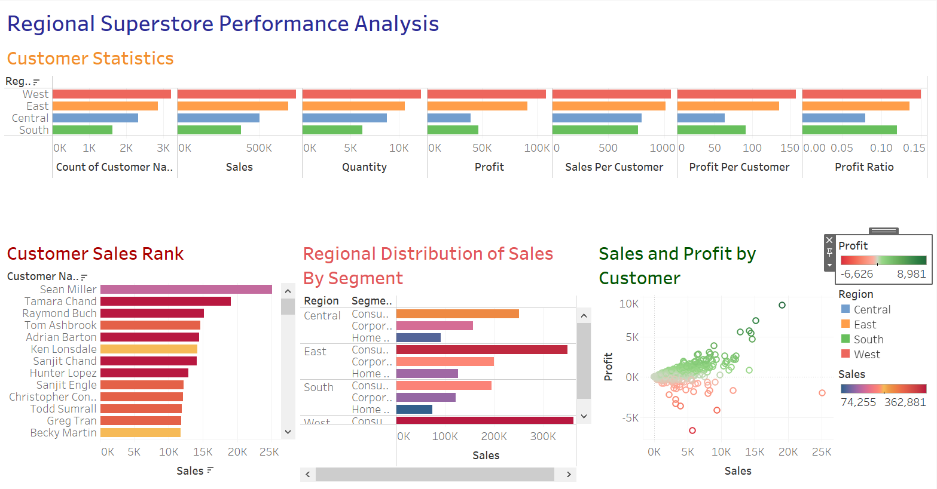
Dashboard

Slide 6
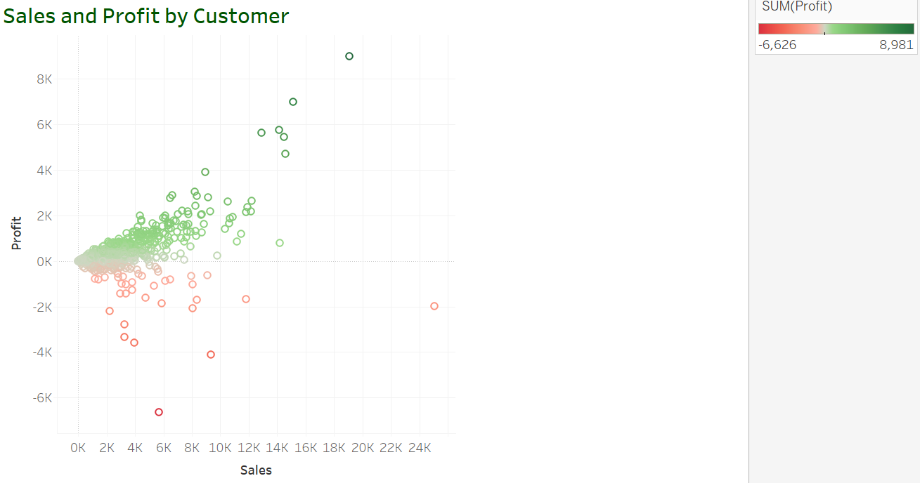
SALES & PROFIT BY CUSTOMER
A positive correlation is evident between sales and profit beyond the break-even point, while a negative correlation is observed when the profit turns negative. The profit ratio is positively measured at 0.48, indicating a favorable relationship between profit and revenue. Notably, the outlier profit ratio stands at -1,467, underscoring the magnitude of the loss relative to the total revenue.

Slide 7
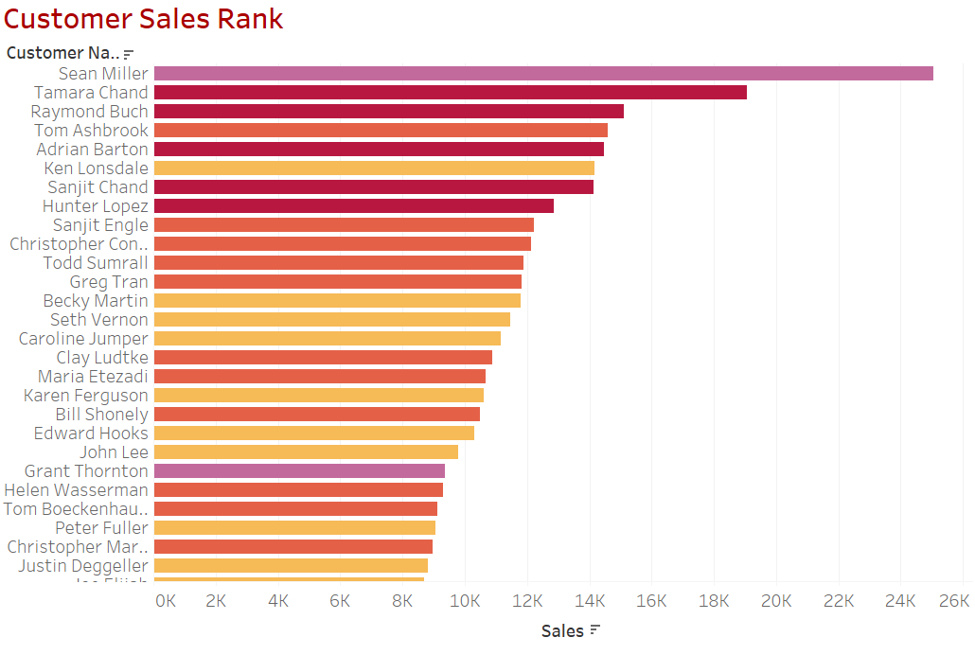
CUSTOMER SALES RANK
Sean Miller achieved the highest sales at $25,043.00, while Thais Sissman recorded the lowest sale at $5.00. The elevated sales figures for Sean may suggest a positive customer perception, satisfaction, and trust in the product, whereas the lower sales for Thais could be attributed to potential challenges in customer perception, satisfaction, and trust. The majority of customers fall within the sales range of $0 to $5,500.00.

Slide 8
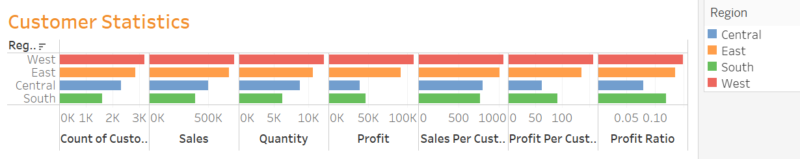
CUSTOMER STATISTICS
This bar chart illustrates the count of customers, sales, and profit per customer, along with the quantity, sales, and profits for each respective region. It appears that the west has the highest customer base which reflects in the sales ($ 725,458.00), and profit ($108,418.00). The South has the lowest customer pool which is evident in its sale ($ 391,722) and profit ($ 46,749.00).

Slide 9
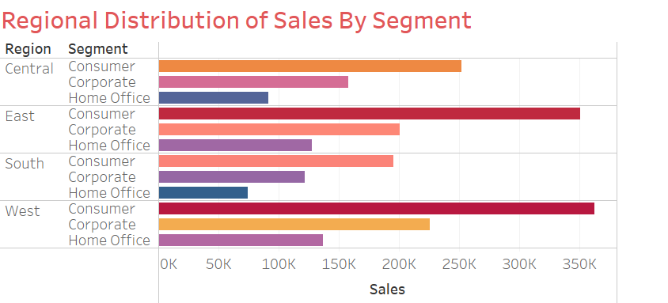

OTHER RELEVANT INFORMATION
The distribution reveals a higher consumption of superstore goods by general consumers, followed by the corporate sector and then the home office. Notably, the West region demonstrates a larger customer base, while the South region has the lowest number of customers.

Slide 10
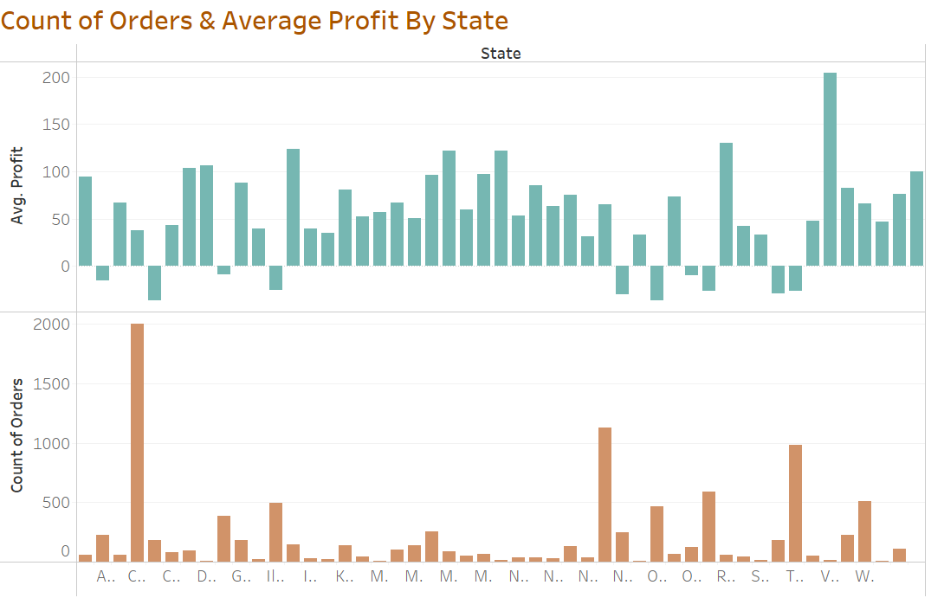
OTHER RELEVANT INFORMATION
California registers the highest order count at 2,001, yet it demonstrates a comparatively lower average profit of 38.2. Conversely, Vermont, with a significantly lower order count of 11, exhibits a notably higher average profit of 204.1.
The discrepancy in average profit between the two states may be influenced by various factors, such as order sizes, product preferences, or pricing structures specific to each region. Additional analysis is necessary to understand the underlying reasons for the observed differences in average profit despite the varying order counts.
10

Slide 11
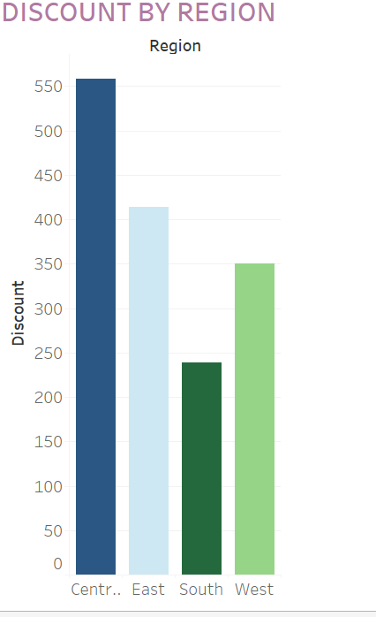

OTHER RELEVANT INFORMATION
The variation in discount amounts between the Central and South regions could be attributed to several factors, including regional pricing strategies, market demand, or competitive dynamics. The Central Region, having the highest discount amount at $558.30, might be employing more aggressive discounting strategies to stimulate sales, meet revenue targets, or gain a competitive edge in a potentially more competitive market.
Conversely, the South Region, with the least discount amount at $238.50, may have a different market dynamic where discounts are applied more conservatively, possibly due to higher product demand, premium pricing strategies, or other regional considerations. Further analysis and insights into regional sales performance, customer behavior, and market conditions would be required to fully understand the reasons behind the observed variations in discount amounts.
11

Slide 12
SUMMARY & CONCLUSION
A dashboard provides a consolidated and visually intuitive representation of key data metrics, offering a comprehensive overview that enables quick and informed decision-making. Its interactive nature facilitates dynamic exploration of datasets, allowing users to identify patterns, trends, and outliers effortlessly. Dashboards enhance data communication by presenting complex information in a digestible format, fostering a deeper understanding among stakeholders. Real-time updates ensure that users have access to the latest insights, contributing to proactive decision-making. With customizable visuals and user-friendly interfaces, dashboards empower users across various roles to derive actionable insights, optimize processes, and ultimately enhance overall business performance.
Tableau is integral in crafting impactful dashboards due to its powerful data visualization capabilities. The platform's user-friendly interface enables the creation of dynamic and interactive dashboards, allowing for a comprehensive representation of complex datasets. Tableau's robust features facilitate the exploration of data trends, patterns, and correlations, empowering users to derive meaningful insights. Its versatility in handling diverse data sources and seamless integration with various formats make it an invaluable tool for businesses aiming to transform raw data into actionable intelligence. With Tableau, organizations can enhance decision-making processes, foster data-driven cultures, and communicate intricate information in a visually compelling manner, ultimately driving efficiency and strategic advancements.
12

Slide 13

THANK YOU

